Slide 1
Sprint-1 Case study on Ecommerce Website
Capgemini Technology Services India Limited
Presented by-
Tanu Srivastava
Batch-3
Employee Id- 46235372

Slide 2
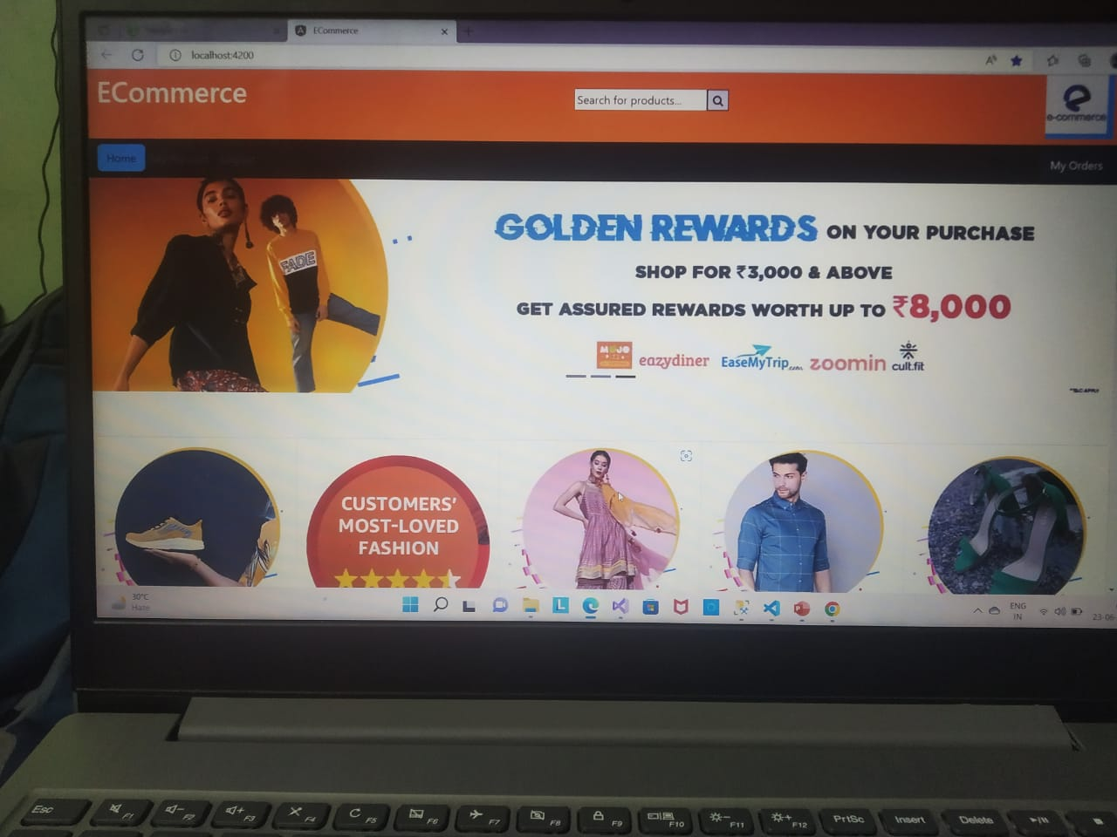
Contents
Overview
Data flow in
Website
Some useful
diagrams
References

Slide 3
Overview
Ecommerce website has been created by using following applications-
Microsoft SQL Server Management Studio,
Microsoft Visual Studio
Visual Studio Code

Slide 4
Data flow in website
DataBase
(Microsoft SQL Server Management Studio)
cWeb Api
(Microsoft Visual Studio)
Ecommerce Web App
(Visual Studio Code)

Slide 5
Proposed System
MODULES
USER
ADMIN
In this module, administrator has to add, update and delete the details of the Product.
In this module, users can see and buy the product and register the new user.

Slide 6
Database diagram of E-commerce website
PRODUCT Table
ID: int
ProductName: varchar
ProductDescription: varchar
CatId: int
ProductImage: varchar
ProductMrp: decimal
ProductQuantity: int
LOGIN Table
ID: int
UserName: varchar
Password: varchar
Is admin : int

Slide 7
References
Bootstrap
E-commerce websites
You Tube

Slide 8
Thank you

